Slide 1
Forecasting

Slide 2
Forecasting Is Extrapolating!
First, note that:
Forecasting is extrapolating

Slide 3
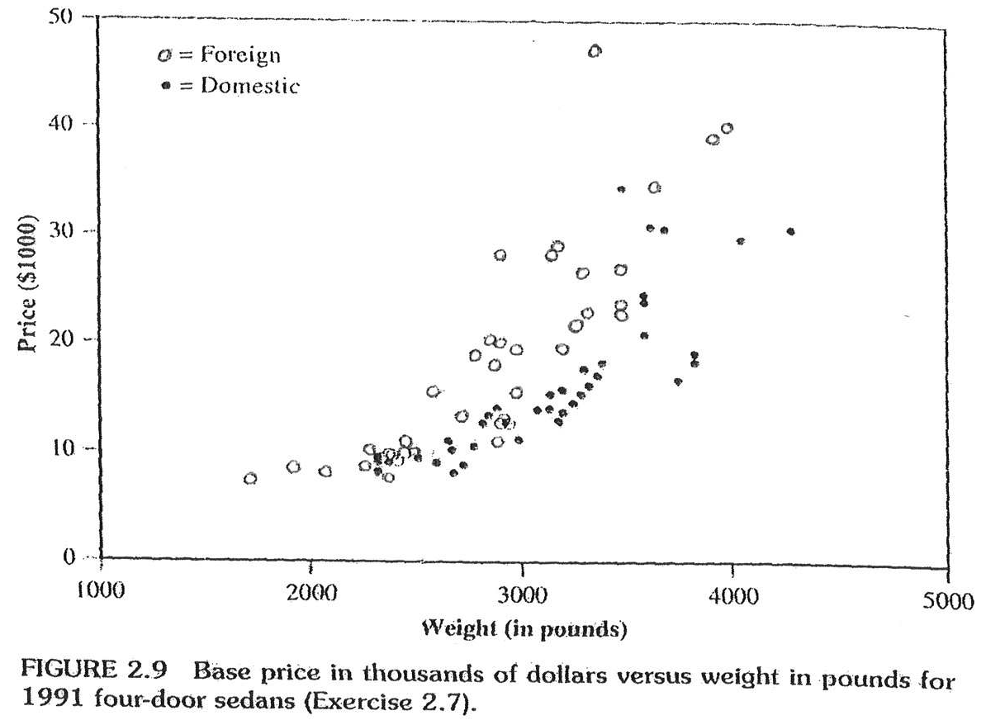
STAT 5371 Example
Predict the price of a car that weighs 3500 pounds.
Extrapolation would say that it’s about $16,000.

Slide 4
STAT 5371 Example
Predict the price of a car that weighs 3500 pounds.
Oops!
Extrapolation would say that it’s about $16,000.

Slide 5
Note: Forecasting is extrapolating.
Lesson from regression analysis and 5371 example?
Be careful when extrapolating!
However, it’s not very important to:
“Predict” the sunspot number for 2012
“Predict” sales for the previous quarter
...
Sometimes we need to extrapolate!
That is, sometimes we need to forecast!

Slide 7
Various Forecasts

Slide 8
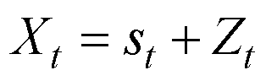
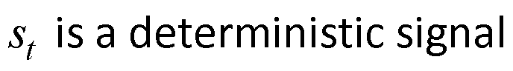
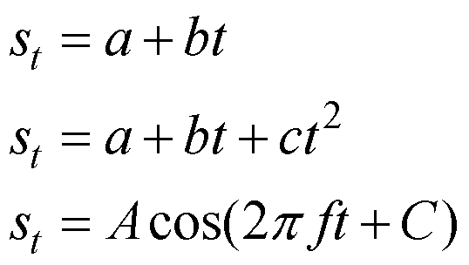
Deterministic Signal-Plus-Noise Models
Example signals:
, C constant

Slide 9
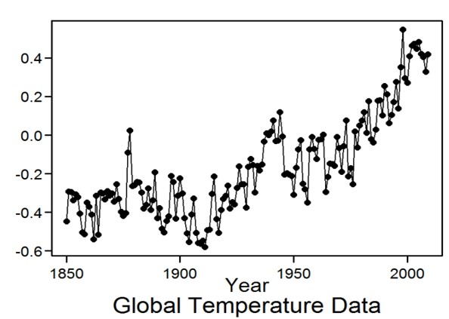
Recall: Sometimes it’s not easy to tell whether a deterministic signal is present in the data
Is there a deterministic signal?

Slide 10
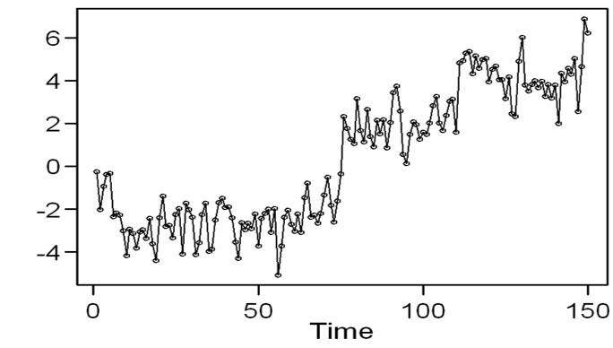
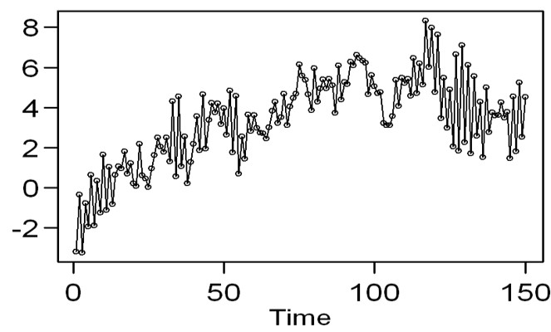
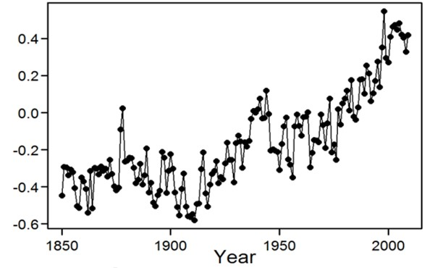
Realizations:
Is there a deterministic signal?
Recall: Sometimes it’s not easy to tell whether a deterministic signal is present in the data.
Global temperature data

Slide 11
How Would You Predict/Forecast into the Future?
It depends on the model.
Global temperature data

Slide 12
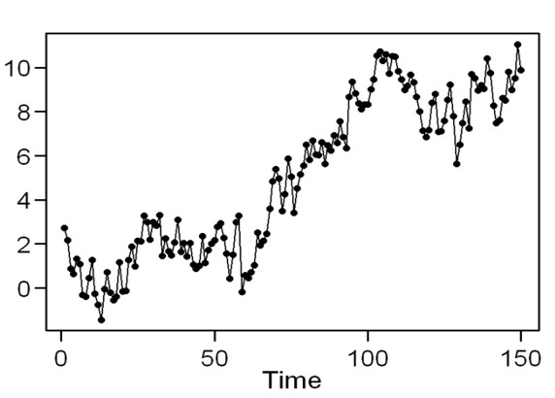
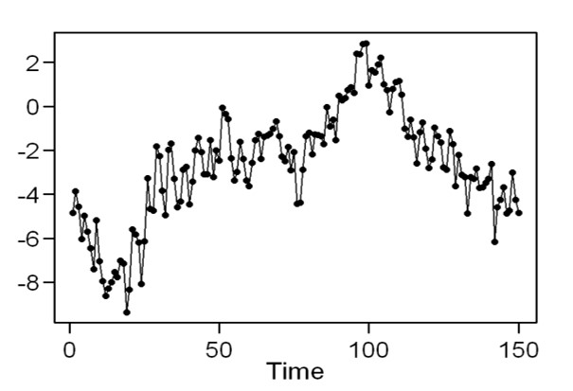
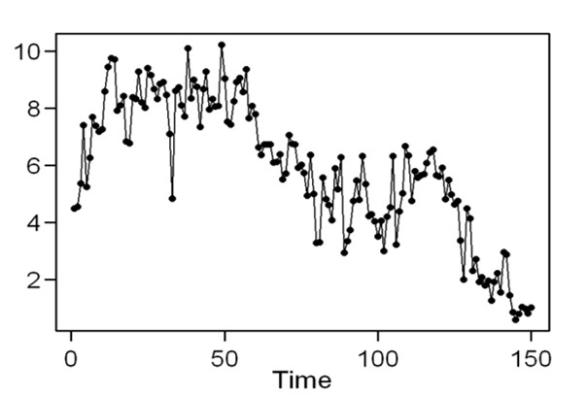
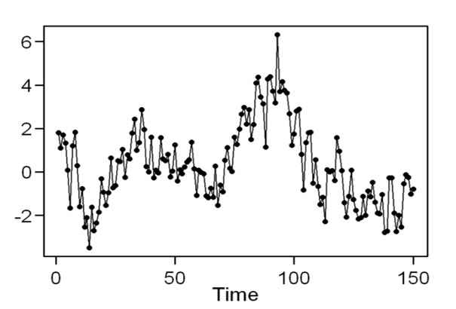
Suppose I told you that this is a realization from the stationary model
Other realizations
(from this model)
Now which forecast do you choose?

Slide 14
Forecasting Setting

Slide 15
Forecasting Setting in this Chapter
Forecast future behavior of a time series given a finite realization of its past.
The use of ARMA models for this purpose has become popular in recent years.
ARMA forecasting vs. curve fitting
Curve fitting (regression)
Underlying assumption that future behavior follows some deterministic path with only random fluctuations
ARMA and other time series-based forecasting
Underlying assumption is that the future is guided only by its correlation to the past

Slide 16
Box-Jenkins Approach
G. E. P. Box and G. M. Jenkins popularized the use of ARMA models for forecasting.
The most recent version of their classic text is Box, Jenkins, and Reinsel (2008).
We will utilize their approach for obtaining ARMA, ARIMA, and seasonal forecasts.
In lecture and in tswge
Important
In this unit, we will assume that we know the true model (i.e., p, q, the ϕ’s and θ ’s).

Slide 18
Strategy and Notation

Slide 19
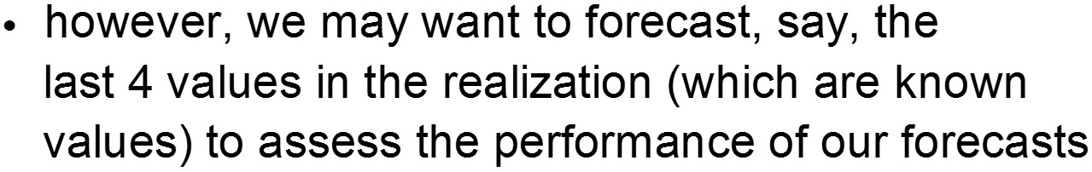
Strategy and Notation
Note:

Slide 20
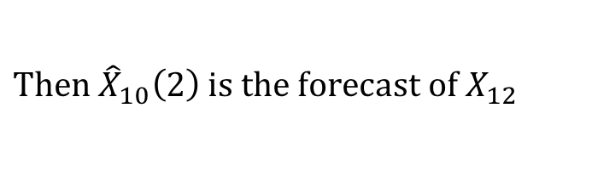
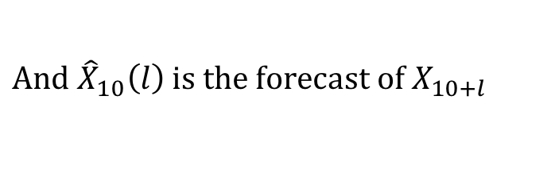
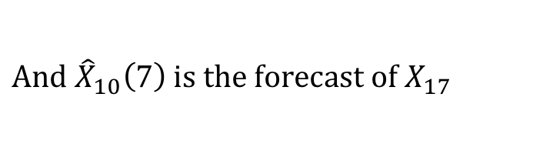
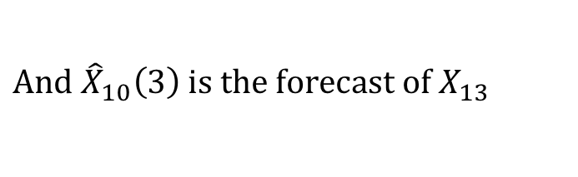
Strategy and Notation
$Then {\hat{X}}_{10}\left(2\right) is the forecast of X_{12}$
$And {\hat{X}}_{10}\left(3\right) is the forecast of X_{13}$
$And {\hat{X}}_{10}\left(7\right) is the forecast of X_{17}$
$And {\hat{X}}_{10}\left(l\right) is the forecast of X_{10+l}$

Slide 21
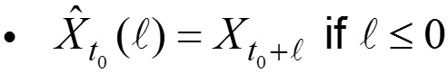
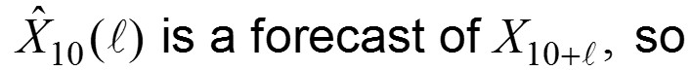
Strategy and Notation
And so on

Slide 23
Forecasting with AR(1)

Slide 24
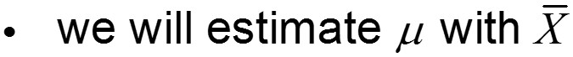
Forecasting Using an AR(1) Model
Suppose that X_{t} is AR(1) (i.e., X _{t} −ϕ₁X _{t−1} = (1−ϕ₁)μ + a _{t}).
Light board
Notes:
recall that we are assuming we know ϕ₁
however, we still can’t use this formula to calculate X₁₂ because we don’t know:
X₁₁, a₁₂, and μ

Slide 25
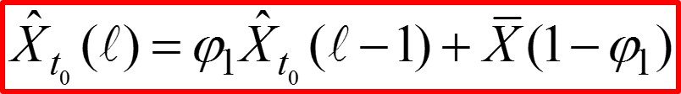
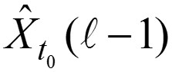
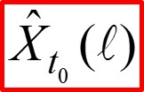
General Forecasting Formula for an AR(1)
Light board
Note:
This formula is used recursively.
That is, we iteratively calculate:
•
•
•

Slide 26
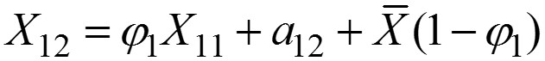
Forecasting Using an AR(1) Model (Example)
Light board
Based on data to time t = 10, we still can’t calculate X₁₂ because we don’t know X₁₁ or a₁₂.
Strategy: We will need to forecast X₁₂ iteratively (based on data to time t =10).
First: We forecast X₁₁ based on data to time t = 10.
replacing actual (unknown) values with forecasts as of t = 10

Slide 27
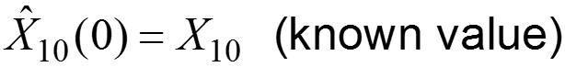
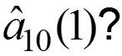
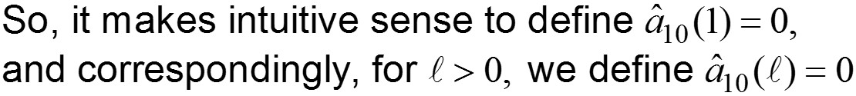
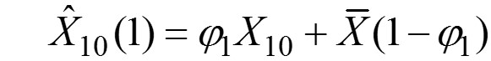
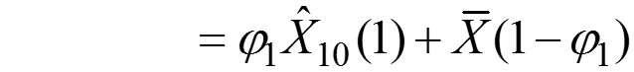
Forecasting Using an AR(1) Model (Example)
Light board
Recall:
How about:
Now:
(which we can calculate)
And finally:
(which again we can calculate)

Slide 28
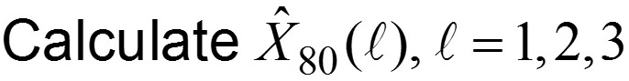
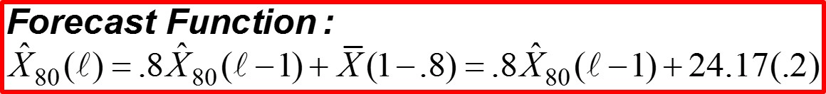
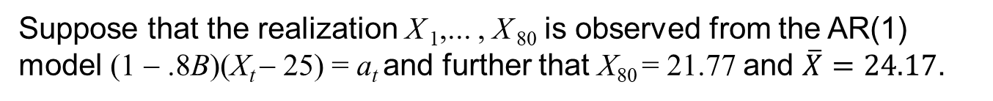
Example: AR(1) forecasts
Suppose that the realization X ₁,... , X ₈₀ is observed from the AR(1) model (1 − .8B)(X_{t} − 25) = a_{t} and further that X₈₀ = 21.77 and $\overline{X}=24.17$.
(These data are in tswge file fig6.1nf.)
Light board
4.83
Notes:
Start with the top material written on the board to start and say most of the wods without writing them down.

Slide 30
Example
Forecasting with an AR(1) Model

Slide 31
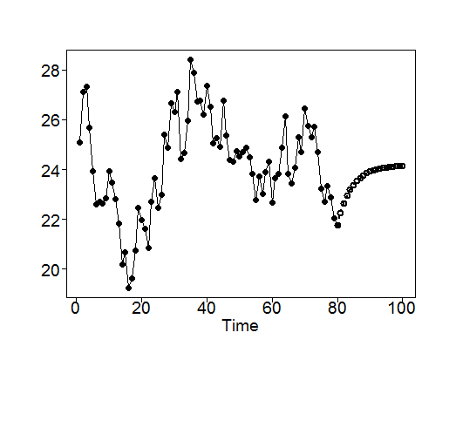
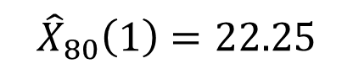
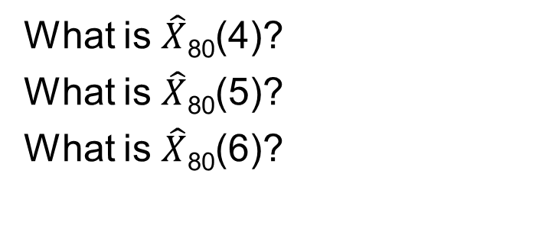
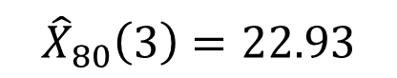
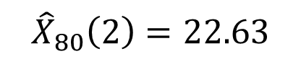
Example: AR(1) forecasts
$${\hat{X}}_{80}\left(1\right)=22.25$$
What is $\hat{X}$₈₀(4)?
What is $\hat{X}$₈₀(5)?
What is $\hat{X}$₈₀(6)?
23.17
23.37
$${\hat{X}}_{80}\left(2\right)=22.63$$
23.52
$${\hat{X}}_{80}\left(3\right)=22.93$$
•
•
•
•
•
•
Notes:
Xhat = 22.25 (Take out calcluations.)

Slide 33
Forecasting with AR(2) and AR(p)

Slide 34
Basic Formula for AR(p) Forecasts
Example: AR(2)
Forecasts
Light board

Slide 36
Example
Forecasting with an AR(2) Model

Slide 37
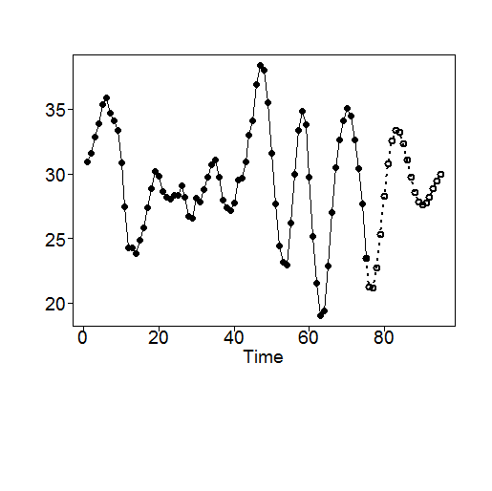
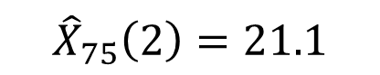
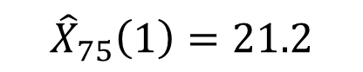
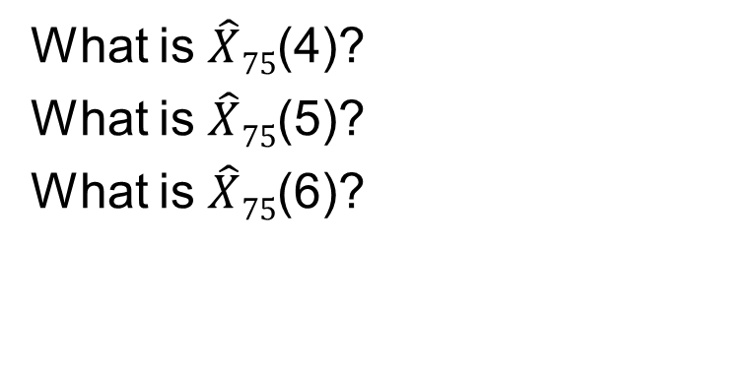
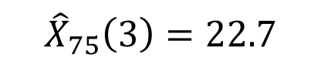
Example: AR(2) forecasts
$${\hat{X}}_{75}\left(1\right)=21.2$$
What is $\hat{X}75$(4)?
What is $\hat{X}75$(5)?
What is $\hat{X}75$(6)?
25.3
28.2
$${\hat{X}}_{75}\left(2\right)=21.1$$
30.8
$${\hat{X}}_{75}\left(3\right)=22.7$$
•
•
•
•
•
•

Slide 39
tswge
Forecasting AR(p) Models

Slide 40
tswge Forecasting Examples
AR(1) example (revisited)
Realization X ₁,... , X ₈₀ in tswge file fig6.1nf from the AR(1) model (1 − .8B)(X_{t} − 25) = a_{t}
data(fig6.1nf)
fore.arma.wge(fig6.1nf,phi=.8,n.ahead=20,plot=TRUE,limits=FALSE)
These commands plot the realization and the n.ahead=20 forecasts shown below. The values of the forecasts are in $f of the output.

Slide 41
tswge Forecasting Examples
AR(2) example (revisited)
Realization X ₁,... , X ₇₅ from the AR(2) model (1 − 1.6B + .8B²)(X_{t} − 25) = a_{t}
x2=gen.arma.wge(n=75,phi=c(1.6,-.8),sn=24)
x2=x2+25
fore.arma.wge(x2,phi=c(1.6,-.8),n.ahead=20,limits=FALSE)
These commands plot the realization and the n.ahead=20 forecasts shown below. The values of the forecasts are in $f of the output.

Slide 43
Eventual Forecast Function

Slide 44
Eventual Forecast Function
Two key observations from two previous forecast plots obtained using:
In both cases, the forecasts behave like the autocorrelations.
AR(1) case: forecasts have exponential shape (although increasing instead of decreasing)
AR(2) case: forecasts look like a damped sinusoid (AR part has complex conjugate roots)

Slide 45

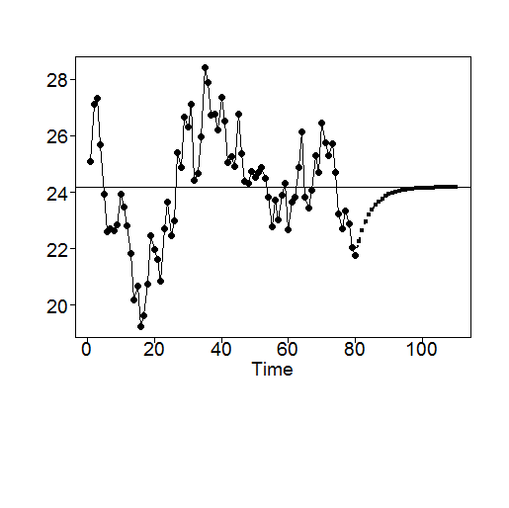
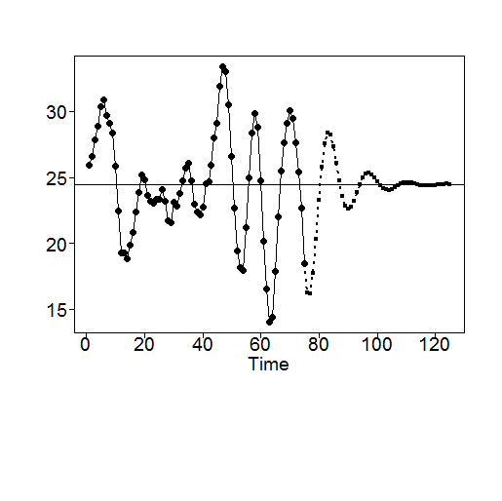
Eventual Forecast Function
The forecasts tend toward the realization mean as number of steps ahead increases.
AR(1) with 30 forecasts
AR(2) with 50 forecasts

Slide 47
Basic Formula for Forecasting with ARMA(p,q)

Slide 48
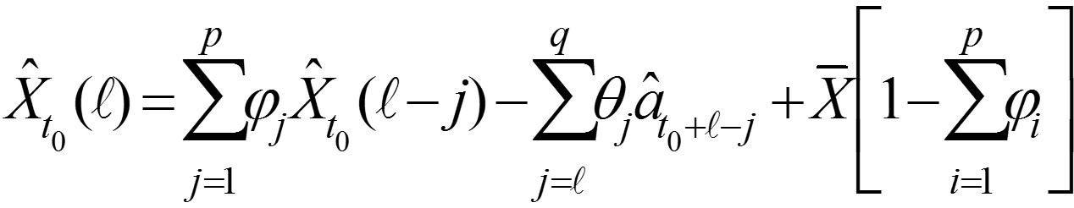
Basic Formula for ARMA(p,q) Forecasts
Note: These forecasts depend on white-noise variance estimates. Obtaining these estimates is computationally intensive. (See Woodward et al. (2017).)
The MA part of the model affects the forecasts, and the eventual forecasts behave in much the same way as they would for the AR part of the model.
In practice, we will obtain ARMA(p,q) (and AR(p)) forecasts using tswge function fore.arma.wge.

Slide 50
tswge
ARMA(p,q) Forecast Examples

Slide 51
tswge Forecasting Examples
ARMA(2,1) example in Woodward et al. (2017)
x2=gen.arma.wge(n=75,phi=c(1.6,-.8),sn=24)
x2=x2+25
fore.arma.wge(x2,phi=c(1.6,-.8), n.ahead=20,limits=FALSE)
fore.arma.wge(x2,phi=c(1.6,-.8), theta = -.9, n.ahead=20,limits=FALSE)
See Woodward et al. (2017) Appendix 6B for more details.
Notes:
Show the contrast with AR(2) and ARMA(2,1)

Slide 53
tswge
Canadian Lynx Example

Slide 54
tswge Forecasting Examples: Canadian Lynx
Show how increasing the order of the AR factor helps grab the cycle in the data AR(4), ARMA(4,1), and AR(11).
(1 – 1.3B + 0.7B² – 0.1B³ + 0.2B⁴)(X_{t} – 2.9) = a_{t}
AR(4): phi = c(1.3, –0.7, 0.1, –0.2)
(1 – 0.7B – 0.1B² + 0.2B³ + 0.3B⁴) (X_{t} – 2.9) = (1 + .6B)a_{t}
ARMA(4,1): phi = c(0.7, 0.1, –0.2, –0.3), theta = –.6
AR(11)
phi = c(1.1676, –0.5446, 0.2662, –0.3094, 0.1540, –0.1463, 0.0569, –0.0294, 0.1346, 0.2021, –0.3394)
fs4 = fore.arma.wge(llynx,phi = c(1.3, -0.7, 0.1, -0.2),n.ahead = 40,limits = FALSE)
fs41 = fore.arma.wge(llynx,phi = c(0.7, 0.1, -0.2, -0.3), theta = -.6,n.ahead = 40,limits = FALSE)
fs11 = fore.arma.wge(llynx,phi = c(1.1676, -0.5446, 0.2662, -0.3094, 0.1540, -0.1463, 0.0569, -0.0294, 0.1346, 0.2021, -0.3394),n.ahead = 40,limits = FALSE)

Slide 56
Probability Limits and ARMA Forecasts
Setting

Slide 57
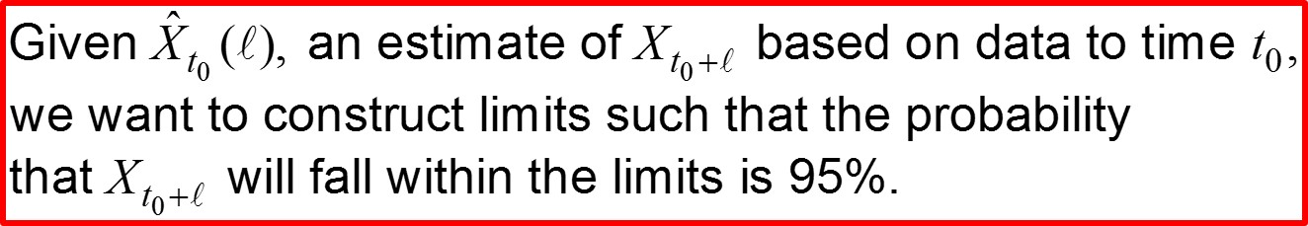
Probability Limits for ARMA Forecasts
Setting
Recall

Slide 58
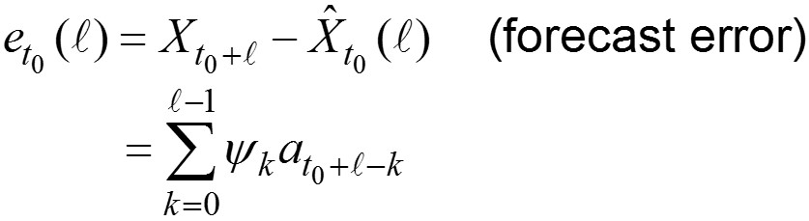
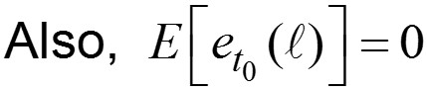
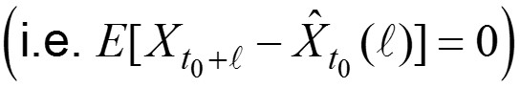
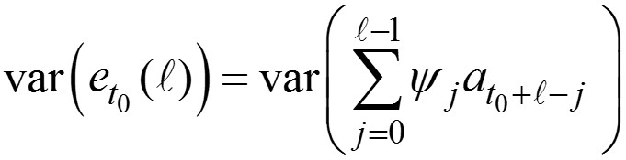

Probability Limits for ARMA Forecasts
Facts
A.
B.
C.
D.

Slide 60
Psi Weights and ARMA Models

Slide 61
A Note About the ψ_{j}’s for ARMA(p,q) Models
can be expressed as
Recall?: The ratio of two polynomials is a (possibly infinite order) polynomial.
See Woodward et al. (2017) for more details concerning calculating ψ-weights.

Slide 63
Calculating Psi Weights for ARMA Models

Slide 64

Example:
(1 − 1.2B + .6B²) X_{t} = (1 − .5B)a_{t .}
Dividing polynomials (remember?)
Light board
1−.5B

Slide 65
Example:
(1 − 1.2B + .6B²) X_{t} = (1 − .5B)a_{t .}
So, in this case, ψ₀ = 1, ψ₁ = .7, ψ₂ = .24, ψ₃ = −.132, …
Light board

Slide 67
tswge and Psi Weights

Slide 68
In practice: We will find ψ-weights using tswge function psi.weights.wge.
Return to example:
(1 − 1.2B + .6B²) X_{t} = (1 − .5B)a_{t .}
We calculated the ψ-weights to be ψ₀ = 1, ψ₁ = .7, ψ₂ = .24, ψ₃ = −.132, …
Using tswge:
psi.weights.wge(phi=c(1.2,-.6),theta=.5,lag.max=5)
gives the output (forψ₁ , …, ψ₅)
[1] 0.70000 0.24000 –0.13200 –0.30240 –0.28368
which agree with the above calculations.
Note: ψ₀ is always equal to 1.

Slide 70
Probability Limits for ARMA Forecasts

Slide 71



Probability Limits for ARMA Forecasts
Light board

Slide 73

95% Probability Limits for Forecasts
Notes:
See Woodward et al. (2017) Chapters 6 and 7.

Slide 74
Probability Limits for ARMA Forecasts with an Example

Slide 75


ARMA(2,1) example:
l | Forecast | Half-width
1 | 51.40 | 1.70
2 | 50.46 | 2.07
3 | 49.73 | 2.11
4 | 49.42 | 2.12

Slide 76


ARMA(2,1) example:
Forecasts with 95% probability limits

Slide 78
tswge and Probability Limits (aka Forecast Limits)

Slide 79
tswge demo: showing forecast limits
To forecast from a stationary ARMA model and show 95% probability limits, use
fore.arma.wge(x,phi,theta,n.ahead,plot=TRUE,limits=TRUE)
Example: Forecasts using the AR(1) model
data(fig6.1nf)
fore.arma.wge(fig6.1nf,phi=.8,n.ahead=20, plot=TRUE,limits=FALSE)
fore.arma.wge(fig6.1nf,phi=.8,n.ahead=20, plot=TRUE,limits=TRUE)

Slide 80
tswge demo
ARMA(2,1) example:
data(fig6.2nf)
fore.arma.wge(fig6.2nf,phi=c(1.2,-.6), theta=.5, n.ahead=20,plot=TRUE,limits=FALSE)
fore.arma.wge(fig6.2nf,phi=c(1.2,-.6), theta=.5, n.ahead=20,plot=TRUE,limits=TRUE)
Notes:
SHOW how halfwidth is the same as in the concept check.

Slide 82
Checking Forecasts
ASE

Slide 83
Checking Forecasts
If n is the length of your time series realization, then sometimes it is useful to set t₀ = n − k and “forecast the last k values in the realization.”
In this way, you can “check” your forecasts with the actual values.
tswge function allows you to do this using the “lastn” option.
If lastn=F, then you forecast past the end of the realization as we have in the previous examples (lastn=F is the default option).
If lastn=T, then you forecast the last n.ahead values in the series.

Slide 84

Checking Forecasts
Again, consider the log lynx dataset. Previously, we have looked at an AR(4) model for these data:
(1 – 1.3B + 0.7B² – 0.1B³ + 0.2B⁴)(X_{t} – 2.9) = a_{t}
114
f = fore.arma.wge(llynx,phi = c(1.3, -0.7, 0.1, -0.2), n.ahead = 12, limits = FALSE)
But how good are these forecasts?
We can’t know because we don’t know the actual values.
AR(4): phi = 1.3, -0.7, 0.1, -0.2
ARMA(4,1): phi = 0.7, 0.1, - 0.2, - 0.3, theta = -.6
(1 - 0.7B - 0.1B2 + 0.2B3 + 0.3B4) (X_{t} – 2.9) = (1 + .6B)a_{t}

Slide 85


Checking Forecasts
Again, consider the log lynx dataset. Previously, we have looked at an AR(4) model for these data:
(1 – 1.3B + 0.7B² – 0.1B³ + 0.2B⁴)(X_{t} – 2.9) = a_{t}
102
f = fore.arma.wge(llynx,phi = c(1.3, -0.7, 0.1, -0.2), n.ahead = 12, lastn = TRUE, limits = FALSE)
We can forecast the last n (12 in this case) values of the series so that we can evaluate the fit.
$$ASE= \frac{\sum{{(\hat{X}}_{i}−}X_{i})2}{n}$$
We will use the average square error (ASE):
AR(4): phi = 1.3, -0.7, 0.1, -0.2
ARMA(4,1): phi = 0.7, 0.1, - 0.2, - 0.3, theta = -.6
(1 - 0.7B - 0.1B2 + 0.2B3 + 0.3B4) (X_{t} – 2.9) = (1 + .6B)a_{t}

Slide 86


Checking Forecasts
Again, consider the log lynx dataset. Previously, we have looked at an AR(4) model for these data:
(1 – 1.3B + 0.7B² – 0.1B³ + 0.2B⁴)(X_{t} – 2.9) = a_{t}
102
f = fore.arma.wge(llynx,phi = c(1.3, -0.7, 0.1, -0.2), n.ahead = 12, lastn = TRUE, limits = FALSE)
$$ASE= \frac{\sum{{(\hat{X}}_{i}−}X_{i})2}{n}=\frac{\sum_{i=1}^{12}{{{(\hat{X}}_{i}−X}_{i})2}}{12}→$$
AR(4): phi = 1.3, -0.7, 0.1, -0.2
ARMA(4,1): phi = 0.7, 0.1, - 0.2, - 0.3, theta = -.6
(1 - 0.7B - 0.1B2 + 0.2B3 + 0.3B4) (X_{t} – 2.9) = (1 + .6B)a_{t}

Slide 87



Checking Forecasts
Next, consider the ARMA(4,1) model we looked at for this data set. Let’s again calculate the ASE for the last 12 observations.
1 – 0.7B – 0.1B² + 0.2B³ + 0.3B⁴)(X_{t} – 2.9) = (1 + .6B)a_{t}
102
f = fore.arma.wge(llynx, phi = c(0.7, 0.1, - 0.2, - 0.3), theta = -.6, n.ahead = 12, lastn = TRUE, limits = FALSE)
$$ASE= \frac{\sum{{(\hat{X}}_{i}−}X_{i})2}{n}→$$
AR(4): phi = 1.3, -0.7, 0.1, -0.2
ARMA(4,1): phi = 0.7, 0.1, - 0.2, - 0.3, theta = -.6
(1 - 0.7B - 0.1B2 + 0.2B3 + 0.3B4) (X_{t} – 2.9) = (1 + .6B)a_{t}

Slide 88
Checking Forecasts
Next, consider the ARMA(4,1) model we looked at for this data set. Let’s again calculate the ASE for the last 12 observations.
AR(4)
(1 – 1.3B + 0.7B² – 0.1B³ + 0.2B⁴)(X_{t} – 2.9) = a_{t}
ARMA(4,1)
1 – 0.7B – 0.1B² + 0.2B³ + 0.3B⁴)(X_{t} – 2.9) = (1 + .6B)a_{t}
102
102
The ASE for the AR(4) model is smaller; therefore, in terms of ASE, the evidence suggests the AR(4) model fits better that the AR(4,1).
AR(4): phi = 1.3, -0.7, 0.1, -0.2
ARMA(4,1): phi = 0.7, 0.1, - 0.2, - 0.3, theta = -.6
(1 - 0.7B - 0.1B2 + 0.2B3 + 0.3B4) (X_{t} – 2.9) = (1 + .6B)a_{t}

Slide 89

Example: Canadian Lynx Data
A classic model fit to the log lynx data is an AR(11) (Tong, 1977).
data(llynx)
f = fore.arma.wge(llynx,phi=c(1.17, -0.54, 0.27, -0.31, 0.15, -0.15, 0.06, -0.03,0.13, 0.20, - 0.34),n.ahead=12,limits=FALSE, lastn = TRUE)
Forecasting last 12 values
102
mean((f$f-llynx[114-12+1])^2

Slide 90




Example: Canadian Lynx Data

Slide 92
tswge
Checking Forecasts

Slide 93

tswge demo: “forecasting” last n.ahead values in your realization
To forecast the last n.ahead values in your data set, use
fore.arma.wge(x,phi,theta,n.ahead,lastn=T,plot=T,limits=F)
Example: Forecasts using the AR(1) model
data(fig6.1nf)
fore.arma.wge(fig6.1nf,phi=.8,n.ahead=10,lastn=TRUE,plot=TRUE,limits=FALSE)

Slide 94
tswge demo: “forecasting” last n.ahead values in your realization
To forecast the last n.ahead values in your data set, use
fore.arma.wge(x,phi,theta,n.ahead,lastn=TRUE)
ARMA(2,1) example:
The ARMA(2,1) data set in fig6.2nf only has 25 data values.
In order to illustrate the “lastn” feature, we generate a longer realization (n=100) from this model.
Notice in the code below that we used sn=8 so that this particular realization can be regenerated.
On the following slide, we illustrate forecasting the last 5, 10, and 20 data values.

Slide 95



tswge demo: “forecasting” last n.ahead values
ARMA(2,1) example:
We can recreate this realization.
x21=gen.arma.wge(n=100,phi=c(1.2,-.6),theta=.5,sn=8)
x21=x21+50
fore.arma.wge(x21,phi=c(1.2,-.6),theta=.5,n.ahead=5, lastn=TRUE)
We also use 10 and 20.
Last 5
Last 10
Last 20
Notes:
ICC with AR(11) from LLYNX DATA
THEN CONCEPT CHECK wth Jet and Delay Data

Slide 96
tswge demo: “forecasting” last n.ahead values
Notes:
Short-term forecasts tended to be pretty good.
For longer steps ahead, the forecasts tended to the mean, 50, shown by the horizontal line.
In all cases, the actual values were within the 95% probability limits.

Slide 97




Example: Canadian Lynx Data
A classic model fit to the log lynx data is an AR(4) (Tong, 1977).
data(llynx) f = fore.arma.wge(llynx,phi=c(1.3, -0.7,0.1,0.2), n.ahead=30, limits=FALSE, lastn = TRUE)
Forecasting last 12 values
Forecasting last 30 values
102
84

Slide 98


Example: Canadian Lynx Data
Another classic model fit to the log lynx data is an AR(11) (Tong, 1977).
data(llynx) f = fore.arma.wge(llynx,phi=c(1.17, -0.54, 0.27, -0.31, 0.15, -0.15, 0.06, -0.03,0.13, 0.20, -0.34),n.ahead=30,limits=FALSE, lastn = TRUE)
Forecasting last 30 values from AR(4)
Forecasting last 30 values from AR(11)
84
84

Slide 100
Introduction
Forecasting with ARIMA

Slide 101

Forecasting with ARIMA
Comments:
forecasts from these models are obtained using a method analogous to that used for ARMA forecasts
we will not calculate these forecasts by hand but will typically use tswge function fore.aruma.wge

Slide 103
Example
Forecasting with ARIMA(0,1,0)

Slide 104
Light board
Example:
Recall: For stationary AR(1)—for example, (1−.9B)(X_{t} −μ) = a_{t}
Our case:
i.e. ϕ₁ =1 instead of .9
Continues to forecast the last data value
Boring
But makes sense
• • •

Slide 106
Example
Forecasting with ARIMA(0,1,0)

Slide 107
Example:
Recall: For stationary AR(1)—for example, (1−.9B)(X_{t} −μ) = a_{t}
Our case:
i.e. ϕ₁ =1 instead of .9
Continues to forecast the last data value
Boring
But makes sense
• • •

Slide 108

Example:
xd1=gen.aruma.wge(n=75,d=1,sn=74)
fore.aruma.wge(xd1,d=1,n.ahead=5,limits=F)
Based on the realization, it’s unclear whether one should forecast the data values to go up or down.
Forecasting the last value seems reasonable.

Slide 109

Example:
xd1=gen.aruma.wge(n=75,d=1,sn=74)
fore.aruma.wge(xd1,d=1,n.ahead=5,limits=T)
Selecting 95% Probability Limits
Shows the uncertainty associated with the forecasts
Could go up or down
Limits seem to be increasing without bound

Slide 110

Example:
Note: Forecasts follow a line determined by the last 2 data values.
That is, the most recent trend is predicted to continue.

Slide 111
Key Concept!
Forecasts the the last value
Forecasts the trend determined by the last two observations

Slide 113
tswge
Generating and Forecasting Simple ARIMA Models

Slide 114
fore.aruma.wge(x,phi,theta,d,s,lambda,n.ahead, lastn=FALSE,plot=TRUE,limits=TRUE)
Example: forecasts using the ARIMA(0,1,0) model
(1 − B) X_{t} = a_{t}
tswge demo
x=gen.aruma.wge(n=50,phi=.8,d=1,sn=15)
fore.aruma.wge(x,d=1,n.ahead=20 , limits = FALSE)
Example: forecasts using the ARIMA(1,1,0) model
(1 − .8B)(1 − B) X_{t} = a_{t}
x=gen.aruma.wge(n=50,phi=.8,d=1,sn=15)
fore.aruma.wge(x,phi=.8,d=1,n.ahead=20 , limits = FALSE)
Example: forecasts using the ARIMA(0,2,0) model
(1 − B)² X_{t} = a_{t}
x=gen.aruma.wge(n=50,phi=.8,d=1,sn=15)
fore.aruma.wge(x,d=2,n.ahead=20, limits = FALSE)

Slide 116
Introduction
Forecasting with Seasonal ARIMA Models

Slide 117



Forecasting with Seasonal Models
Example:
Note:
Given quarterly data, this very simple model forecasts the current quarter to be the value observed for this quarter last year.

Slide 118

Example:
Forecasts:
That is, forecasts are an exact replica of the last s values.

Slide 120
tswge
Generating and Forecasting Simple Seasonal Models

Slide 121
tswge demo
fore.aruma.wge(x,phi,theta,d,s,n.ahead, lastn=FALSE,plot=TRUE,limits=TRUE)
Forecasts from the pure seasonal model
(1 − B ⁴) X_{t} = a_{t}
x=gen.aruma.wge(n=20,s=4, sn = 6)
fore.aruma.wge(x,s=4,n.ahead=8,lastn=FALSE,plot=TRUE, limits=FALSE)
#
x=gen.aruma.wge(n=20,s=4, sn = 6)
fore.aruma.wge(x,s=4,n.ahead=8,lastn=TRUE,plot=TRUE, limits=FALSE)
Example: forecasts using seasonal model
(1 − .8B)(1 − B ⁴) X_{t} = a_{t}
x=gen.aruma.wge(n=20,phi=.8,s=4,sn = 6)
fore.aruma.wge(x,phi=.8,s=4,n.ahead=8,limits=FALSE)
Also: lastn=TRUE

Slide 123
A More General Seasonal Model/ the “Airline Model”

Slide 124


Factor Table: s=12
Factor table for (1 − B¹²)
Factor | Abs Recip | f | Root(s)
1 – B | 1 | 0 | 1
 | 1 | .083 | .866 + .5i
1 − B + B² | 1 | .167 | .5 + .866i
1+B² | 1 | .25 | + i
1 + B + B² | 1 | .333 | −.5 + .866i
 | 1 | .417 | −.866 + .5i
1 + B | 1 | .5 | −1
Note: (1 − B¹²) has a factor of (1 − B) so that the product (1 − B)(1 − B¹²) has two factors of (1 − B).

Slide 125


Forecasts Using the Airline Model
$$\left(1−B12\right)\left(X_{t}−μ\right)=a_{t}$$
Using this model, the data for the last year are forecast into the future.
The trend is not forecast to continue.
In our previous examples:
(1 − B) X_{t} = a_{t} simply forecasts the last data value into the future
(1 − B)² X_{t} = a_{t} forecasts the trend to continue
$$(1−B)\left(1−B12\right)\left(X_{t}−μ\right)=a_{t}$$

Slide 126
More general seasonal model
Forecasts follow general pattern of last s points, but not an exact replica
“Finer detail” incorporated through ϕ (B) and θ (B)

Slide 127
Example: Seasonal Model with Trend
It is called the airline model.
It is useful for modeling and forecasting data similar to the (log) airline data shown below.
Notice that a key feature of this data set is that there is a seasonal component and a trend

Slide 129
Parzen, Box and Woodward / Gray Airline Models

Slide 130

$$φ(B) \left(1−B12\right)\left(X_{t}−μ\right)=a_{t}$$
Where $φ(B)$ is the 13th-order AR operator given by Parzen et al. (1980).
data(airlog) fore.aruma.wge(airlog, d = 0, s = 12, phi = c(.74,0,0,0,0,0,0,0,0,0,0,.38,-.2812),n.ahead = 36,lastn = TRUE, limits = FALSE)
Seasonality predicted to continue… but not the trend
108

Slide 131
$$\text{(1} \text{−} \text{B}\text{)}\left(1−B12\right)\left(X_{t}−μ\right)=θ(B)a_{t}$$
Where $θ(B)$ is the 13th-order MA operator given by Box et al. (2008).
data(airlog) fore.aruma.wge(airlog, d = 0, s = 12, phi = c(.74,0,0,0,0,0,0,0,0,0,0,.38,-.2812),n.ahead = 36,lastn = TRUE, limits = FALSE)
Seasonality predicted to continue… as well as the trend.
108

Slide 132


$$\text{j}\text{1}\text{(}\text{B}\text{)(1}−\text{B}\text{)(1}−\text{B}\text{12}\text{)} \text{X}\text{t} \text{= }\text{a}\text{t}$$
Where ϕ₁(B) is the 12th-order operator given by Woodward et al. (2017).
data(airlog) phi1=c(-.36,-.05,-.14,-.11,.04,.09,-.02, .02,.17,.03,-.10,-.38) fore.aruma.wge(airlog,phi=phi1,d=1,s=12,n.ahead=36,plot=T,lastn=F,limits=F)
Seasonality and trend predicted to continue
144

Slide 133

$$\text{j}\text{1}\text{(}\text{B}\text{)(1}−\text{B}\text{)(1}−\text{B}\text{12}\text{)} \text{X}\text{t} \text{= }\text{a}\text{t}$$
Where ϕ₁(B) is the 12th-order operator given by Woodward et al. (2017).
data(airlog) phi1=c(-.36,-.05,-.14,-.11,.04,.09,-.02, .02,.17,.03,-.10,-.38) fore.aruma.wge(airlog,phi=phi1,d=1,s=12,n.ahead=36,plot=T,lastn=T,limits=F)
Forecasts of last 36 months are so good that it’s difficult to distinguish them from the actual values.

Slide 135
Competition
Parzen, Box, Woodward / Gray —Airline Forecasts, AIC, and ASE

Slide 136

Airline Competition Among the Greats!
Previously, we looked at the structure of the model from three world-renowned statisticians.

Slide 137




Airline Competition Among the Greats!
(1 – .74B)(1 + .38B¹²)(1 – B¹²)(X_{t} − $μ$) = a_{t}
(1 – B)(1 – B¹²)(X_{t} − $μ$) = (1 − .4B) (1 − .6B¹²)a_{t}
(1 + .36B + .05B² + .14B³ + .11B⁴ – .04B⁵ – .09B⁶ + .02B⁷ – .02B⁸
– .17B⁹ – .03B¹⁰ + .10B¹¹ + .38B¹²)(1 – B)(1 – B¹²)(X_{t} − $μ$) = a_{t}

Slide 138
Airline Competition Among the Greats!
(1 – .74B)(1 + .38B¹²)(1 – B¹²)(X_{t} − $μ$) = a_{t}

Slide 139

Airline Competition Among the Greats!
(1 – B)(1 – B¹²)(X_{t} − $μ$) = (1 − .4B) (1 − .6B¹²)a_{t}

Slide 140

Airline Competition Among the Greats!
(1 + .36B + .05B² + .14B³ + .11B⁴ – .04B⁵ – .09B⁶ + .02B⁷ – .02B⁸
– .17B⁹ – .03B¹⁰ + .10B¹¹ + .38B¹²)(1 – B)(1 – B¹²)(X_{t} − $μ$) = a_{t}

Slide 141



Airline Competition Among the Greats!
Now we will compare the actual models they published on the basis of the ASE calculated from forecasts of the last 36 years.
(1 – .74B)(1 + .38B¹²)(1 – B¹²)(X_{t} − $μ$) = a_{t}
(1 – B)(1 – B¹²)(X_{t} − $μ$) = (1 − .4B) (1 − .6B¹²)a_{t}
(1 + .36B + .05B² + .14B³ + .11B⁴ – .04B⁵ – .09B⁶ + .02B⁷ – .02B⁸
– .17B⁹ – .03B¹⁰ + .10B¹¹ + .38B¹²)(1 – B)(1 – B¹²)(X_{t} − $μ$) = a_{t}
?
Box = fore.aruma.wge(airlog,d = 1, s = 12, theta = c(.4,0,0,0,0,0,0,0,0,0,0,.6,-.24),n.ahead = 36,lastn = TRUE, limits = FALSE)
BOX_ASE = mean((airlog[(144-36+1):144] - Box$f)^2)
BOX_ASE
Woodward = fore.aruma.wge(airlog,d = 1, s = 12, phi = c(-.36,-.05,-.14,-.11,.04,.09,-.02, .02,.17,.03,-.10,-.38),n.ahead = 36,lastn = TRUE, limits = FALSE)
WOODWARD_ASE = mean((airlog[(144-36+1):144] - Woodward$f)^2)
WOODWARD_ASE
Parzen = fore.aruma.wge(airlog, d = 0, s = 12, phi = c(.74,0,0,0,0,0,0,0,0,0,0,.38,-.2812),n.ahead = 36,lastn = TRUE, limits = FALSE)
PARZEN_ASE = mean((airlog[(144-36+1):144] - Parzen$f)^2)
PARZEN_ASE

Slide 143
Competition Conclusion

Slide 144




Airline Competition Among the Greats!
Now we will compare the actual models they published on the basis of the ASE calculated from forecasts of the last 36 years.
AIC
(1 – .74B)(1 + .38B¹²)(1 – B¹²)(X_{t} − $μ$) = a_{t}
Which is the “right” model?
Which model is the most useful?
All of these professors would agree that it is nearly certain that none of these are the “right” model!
(1 – B)(1 – B¹²)(X_{t} − $μ$) = (1 − .4B) (1 − .6B¹²)a_{t}
This is up for debate depending on your feeling about AIC vs. ASE. You may want to consider other statistics as well.
(BIC, AICc, RMSE, etc.)
(1 + .36B + .05B² + .14B³ + .11B⁴ – .04B⁵ – .09B⁶ + .02B⁷ – .02B⁸
– .17B⁹ – .03B¹⁰ + .10B¹¹ + .38B¹²)(1 – B)(1 – B¹²)(X_{t} − $μ$) = a_{t}
Box = fore.aruma.wge(airlog,d = 1, s = 12, theta = c(.4,0,0,0,0,0,0,0,0,0,0,.6,-.24),n.ahead = 36,lastn = TRUE, limits = FALSE)
BOX_ASE = mean((airlog[(144-36+1):144] - Box$f)^2)
BOX_ASE
Woodward = fore.aruma.wge(airlog,d = 1, s = 12, phi = c(-.36,-.05,-.14,-.11,.04,.09,-.02, .02,.17,.03,-.10,-.38),n.ahead = 36,lastn = TRUE, limits = FALSE)
WOODWARD_ASE = mean((airlog[(144-36+1):144] - Woodward$f)^2)
WOODWARD_ASE
Parzen = fore.aruma.wge(airlog, d = 0, s = 12, phi = c(.74,0,0,0,0,0,0,0,0,0,0,.38,-.2812),n.ahead = 36,lastn = TRUE, limits = FALSE)
PARZEN_ASE = mean((airlog[(144-36+1):144] - Parzen$f)^2)
PARZEN_ASE

Slide 146
Forecasting Signal-Plus-Noise

Slide 147
Signal-Plus-Noise Forecasts
X_{t} = s_{t} + Z_{t}
tswge allows two cases:

Slide 148
Forecasting Strategy (Linear Case)

Slide 149

In tswge:
fore.sigplusnoise.wge(x, linear = TRUE, freq = 0, max.p = 5, n.ahead = 10, lastn = FALSE, plot = TRUE, limits = TRUE)
x=gen.sigplusnoise.wge(n=50,b0=10,b1=.2, phi=c(.8,-.6))
#
xfore=fore.sigplusnoise.wge(x,linear=TRUE,n.ahead=20,lastn=F,limits=F)
Notice that the realization has a line with cyclic noise. The forecasts for early lags forecast the cyclic behavior, while for longer steps ahead, they trend to the underlying line.

Slide 150
Closing Remarks

Slide 151
Final Note
We have learned how to forecast from a given ARMA, ARIMA, or signal-plus-noise model.
Important point
The model selected makes a big difference in the forecasts.
We saw this in the airline data: We needed a factor of (1 − B) along with (1 − B¹²) to forecast the trend to continue.
How do we fit the parameters to these models?
How do we decide what model to use?
Upcoming Units!

